Slide 1

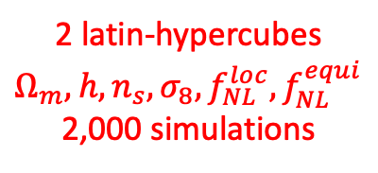

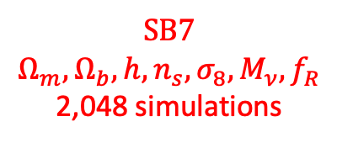

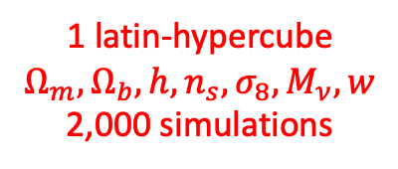
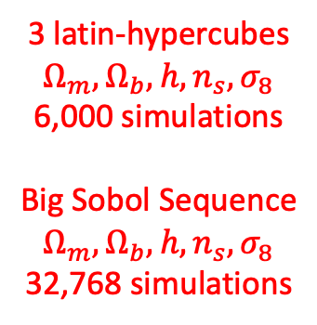
Fiducial model (17,100 simulations)
$$Ω_{m}=0.3175, Ω_{b}=0.049, h=0.6711, n_{s}=0.9624, σ_{8}=0.834,$$
$$w=−1, M_{ν}=0, δ_{b}=0, f_{NL}=0, p_{NL}=0, f\left(R\right)=0$$
Individual parameter variations (23,000 simulations)
$Λ$CDM | Dark energy | Massive neutrinos | Separate Universe | Primordial non-Gaussianities | Parity violation | Modified gravity
$$Ω_{m},Ω_{b},h, n_{s}, σ_{8}$$ | $$w$$ | $$M_{ν}$$ | $$δ_{b}$$ | $$f_{NL}^{local},f_{NL}^{equil},f_{NL}^{ortho}$$ | $$p_{NL}$$ | $$f(R)$$
Multiple parameter variations (44,816 simulations)
3 latin-hypercubes $Ω_{m},Ω_{b},h, n_{s}, σ_{8}$
6,000 simulations
Big Sobol Sequence
$$Ω_{m},Ω_{b},h, n_{s}, σ_{8}$$
32,768 simulations
1 latin-hypercube $Ω_{m},Ω_{b},h, n_{s}, σ_{8}, M_{ν}, w$
2,000 simulations
2 latin-hypercubes $Ω_{m},h, n_{s}, σ_{8},f_{NL}^{loc}, f_{NL}^{equi}$
2,000 simulations
SB7
$Ω_{m},Ω_{b},h, n_{s}, σ_{8}, M_{ν}, f_{R}$
2,048 simulations

